Slide 1
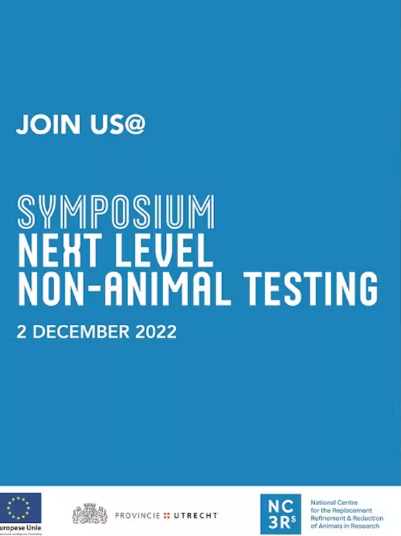
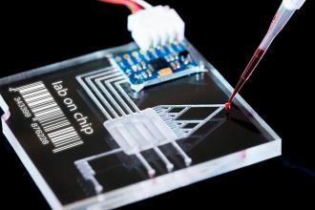
The Netherlands in the lead for non-animal testing

Slide 2
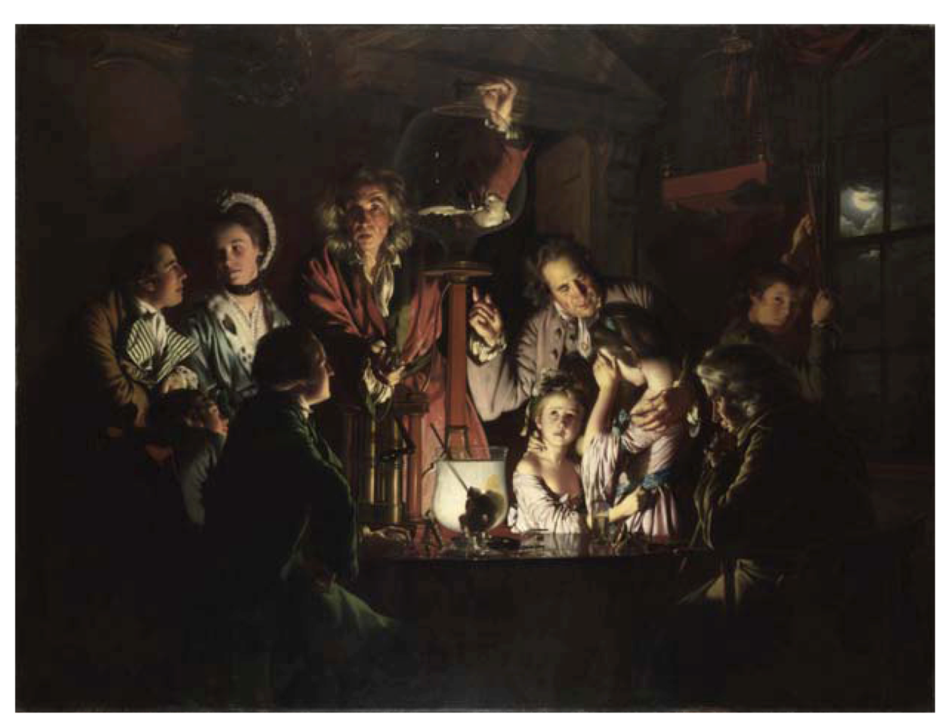

Slide 3
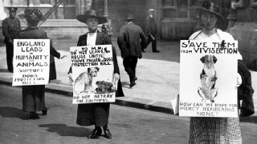
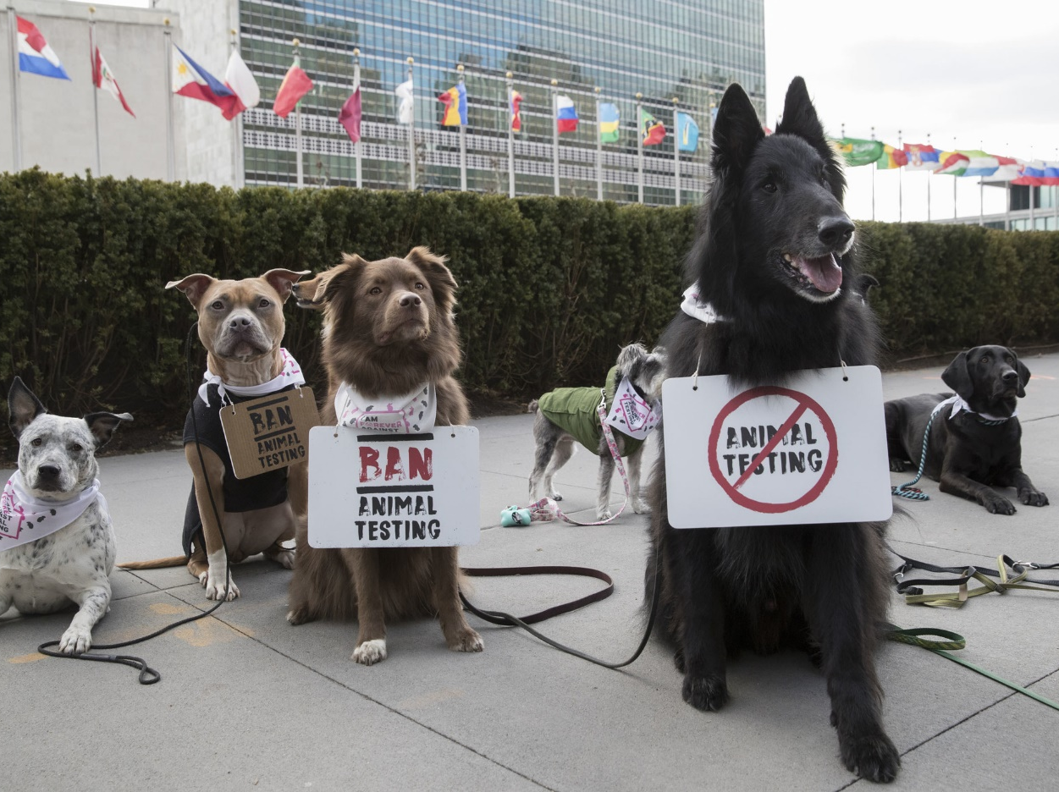
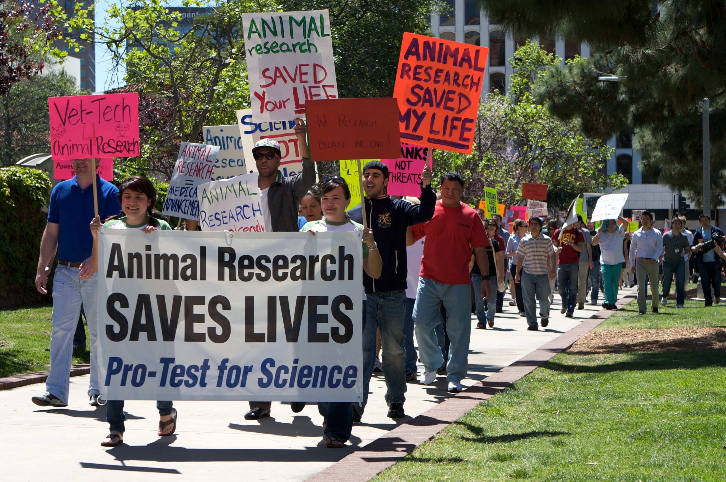
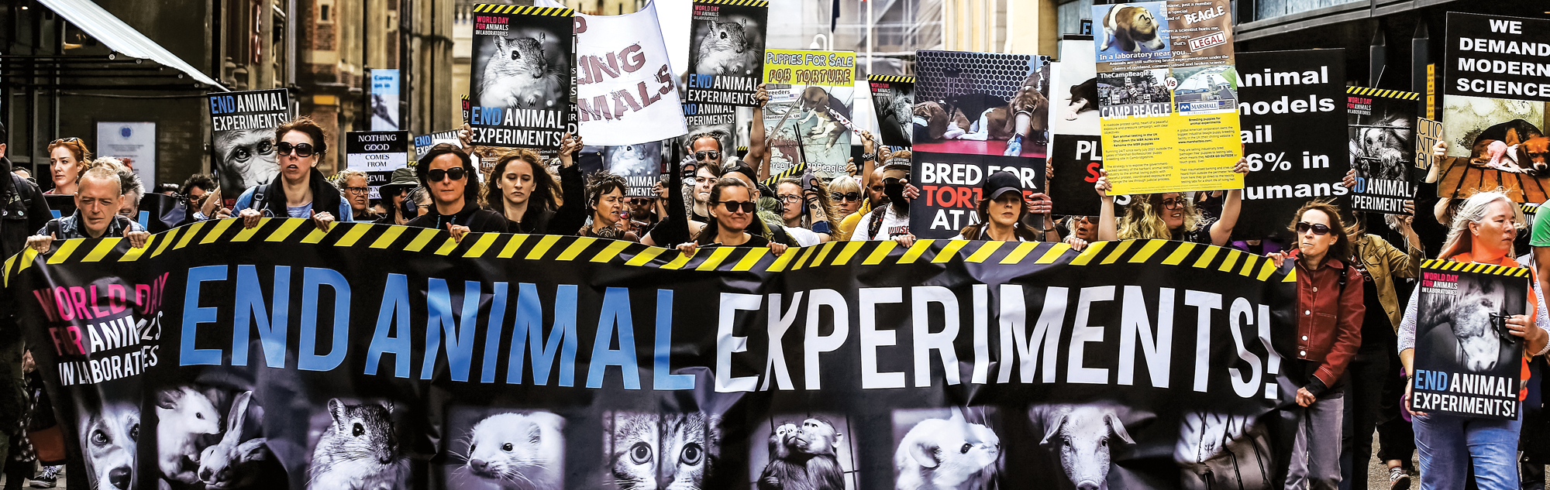
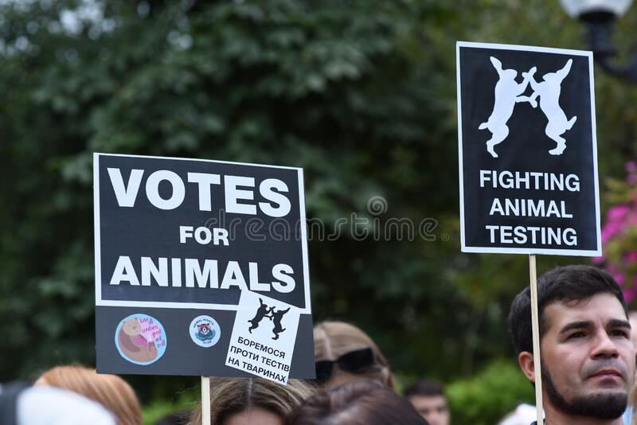

Slide 4
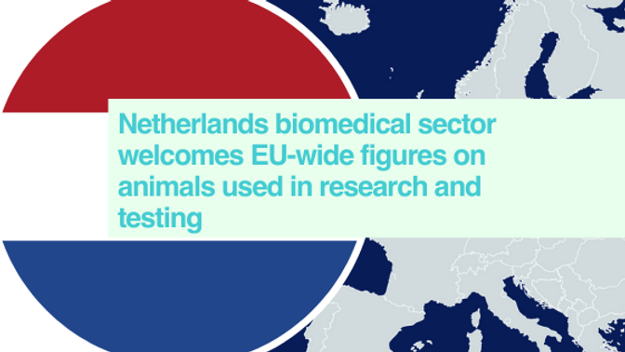
The headline figures in the European Commission report show that the total number of animals used in the EU in 2018 was 8,921,758 - slightly lower than in 2017 (9,388,162). In 2018, 88% of the total were mice, fish and rats, whereas dogs, cats and monkeys account for around 0.3% of the total

Slide 6
Total number of animal experiments in the Netherlands 2016-2020

Slide 7
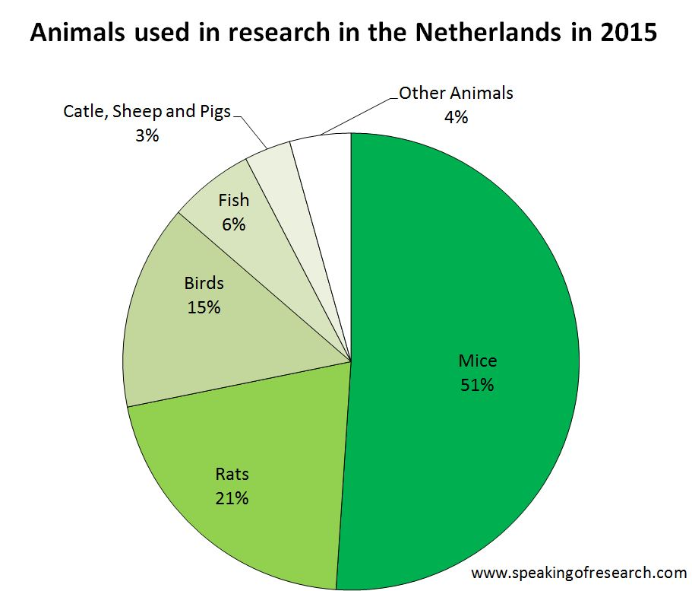

Slide 8
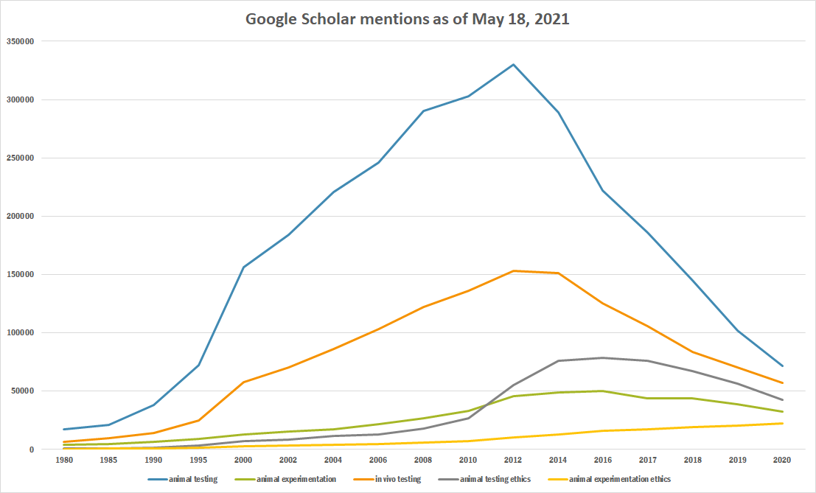
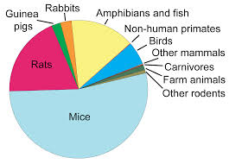
International data

Slide 10
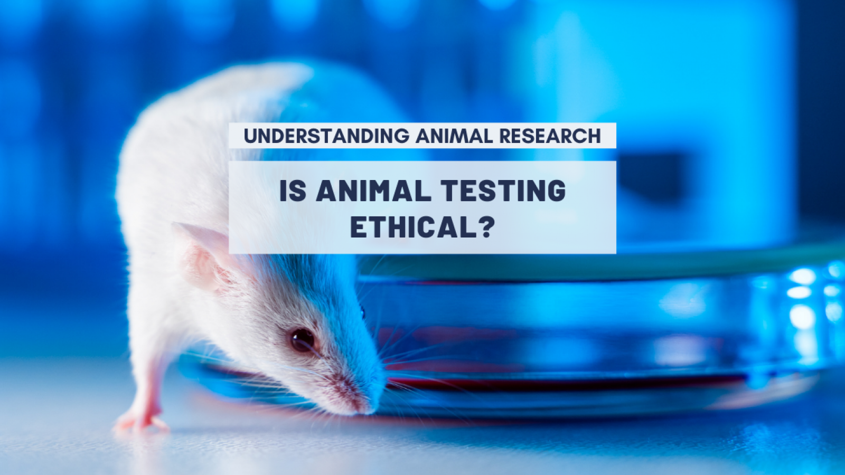
USEFUL?

Slide 11
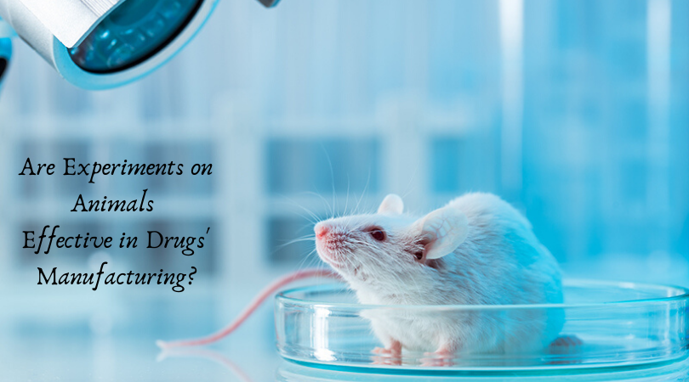

Slide 16
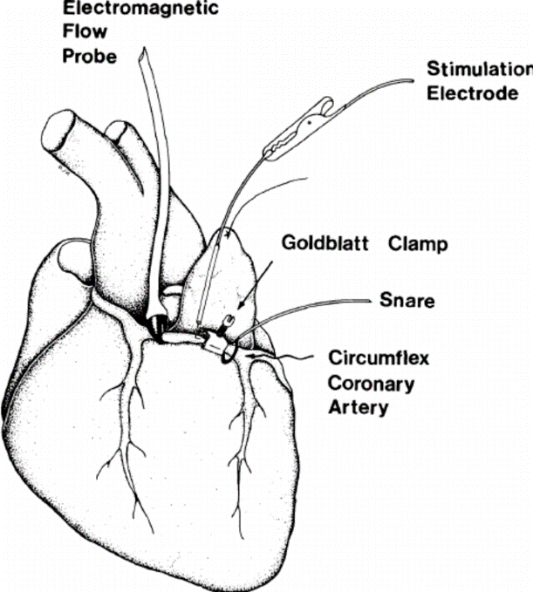
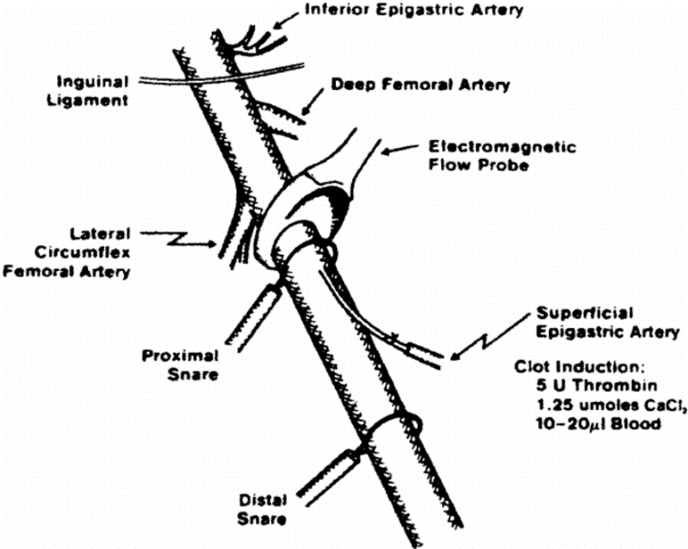

Slide 17
anticoagulants | optimal dose in animal models of venous thrombosis | recommended dose in clinical practice
heparin | 50 U/kg/hr [2.5-400 U/kg/hr] | 15-20 U/kg/hr
nadroparin | 25 anti-Xa U/kg/hr [15-80 anti-Xa U/kg/hr] | 5-9 anti-Xa U/kg/hr
dalteparin | 42 anti-Xa U/kg/hr [5-70 anti-Xa U/kg/hr] | 8-10 anti-Xa U/kg/hr
enoxaparin | 150 mg/kg [20-100 mg/kg] | 20-40 mg/kg
recombinant hirudin | 0.8 mg/kg/hr [0.1-1.4 mg/kg/hr] | 0.15 mg/kg/hr

Slide 18
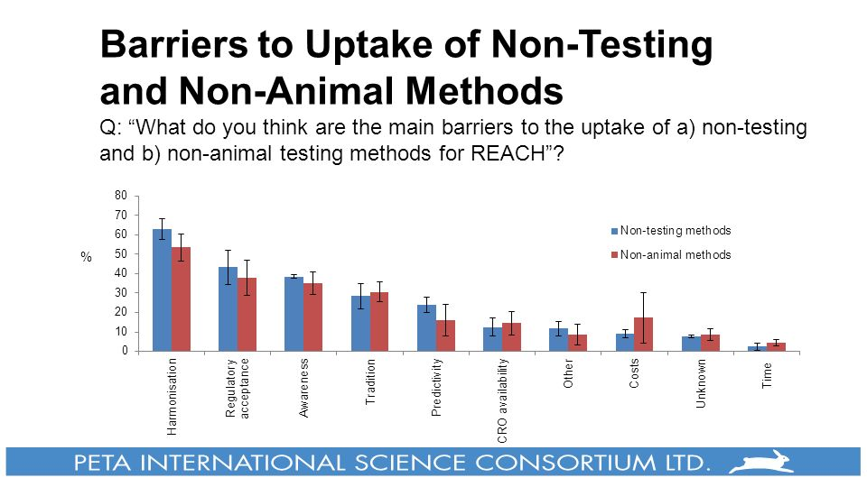

Slide 19
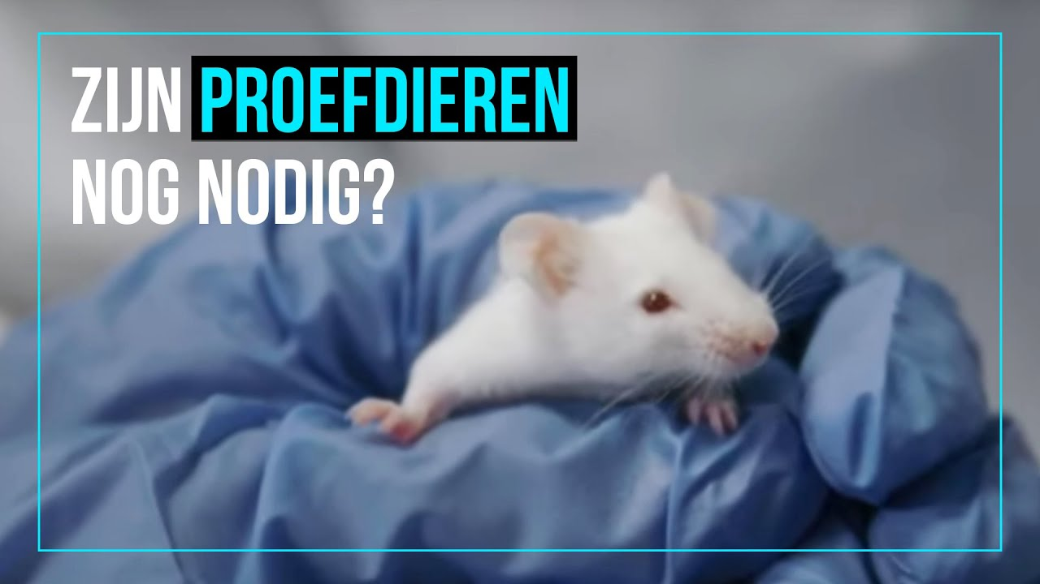
Do we still need animals in research?

Slide 20
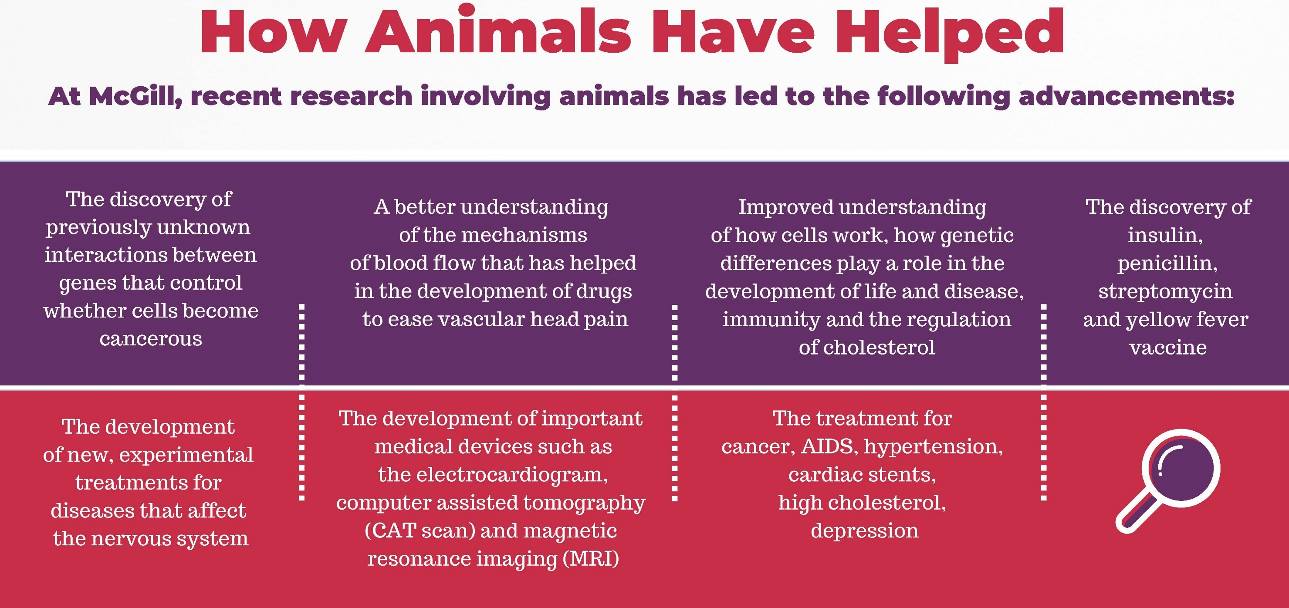

Slide 21
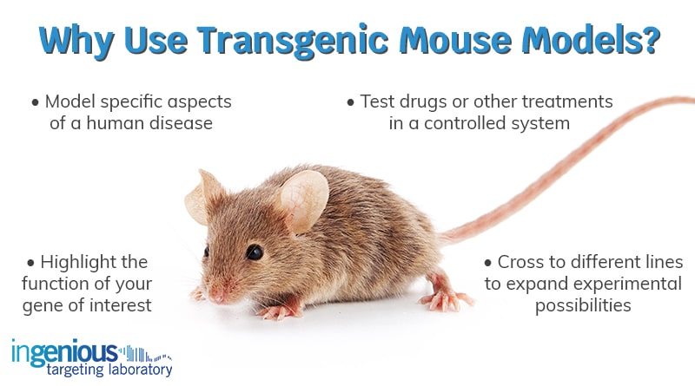

Slide 22
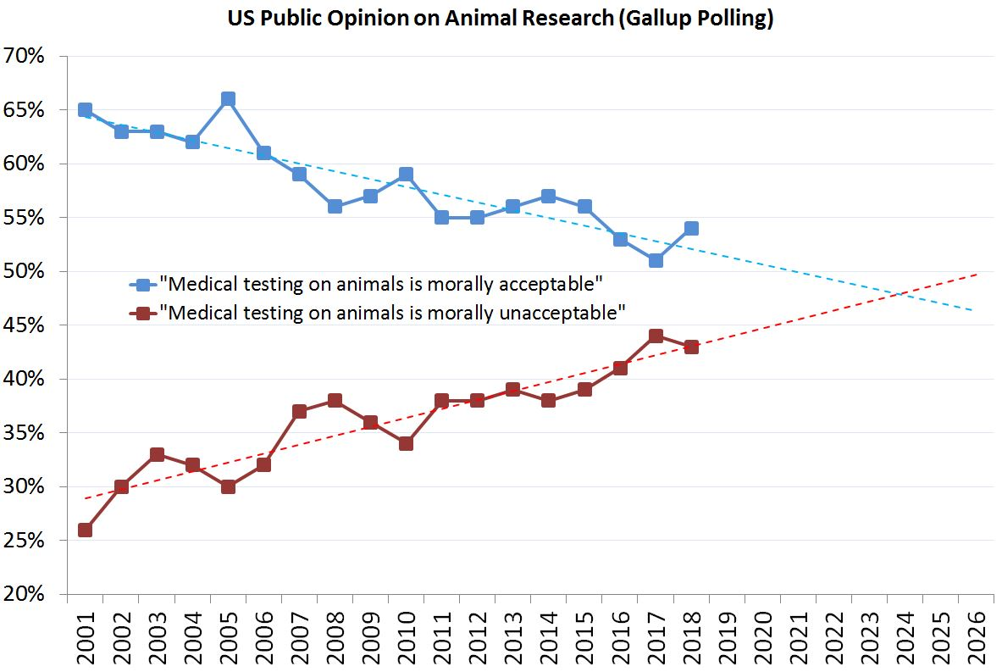

Slide 23
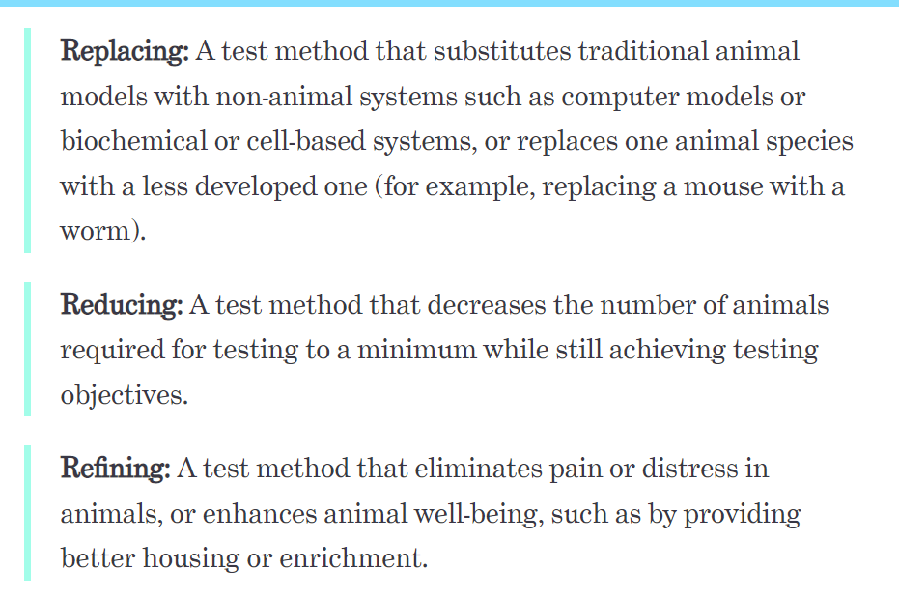

Slide 24
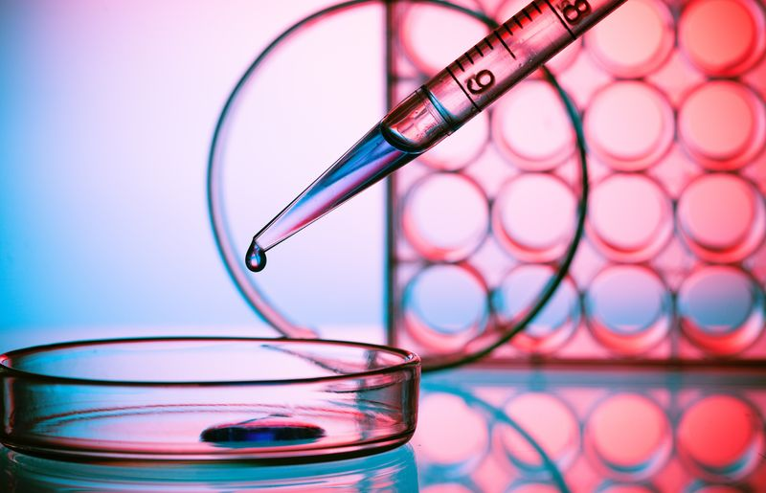
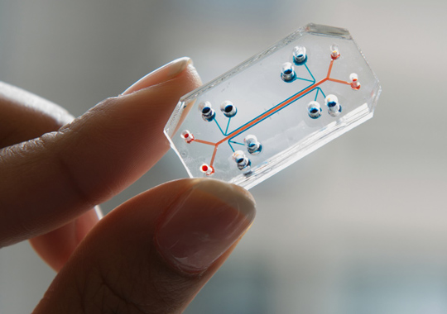
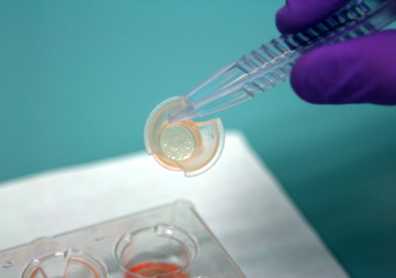

Slide 25
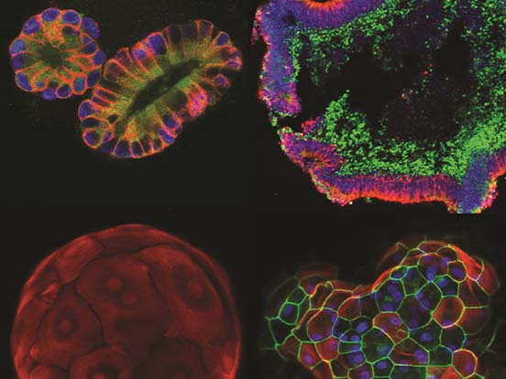

Slide 26
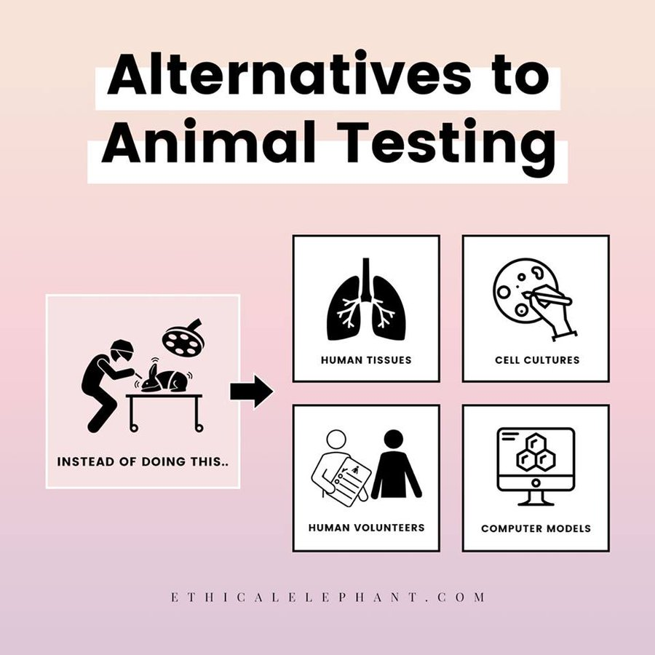

Slide 27
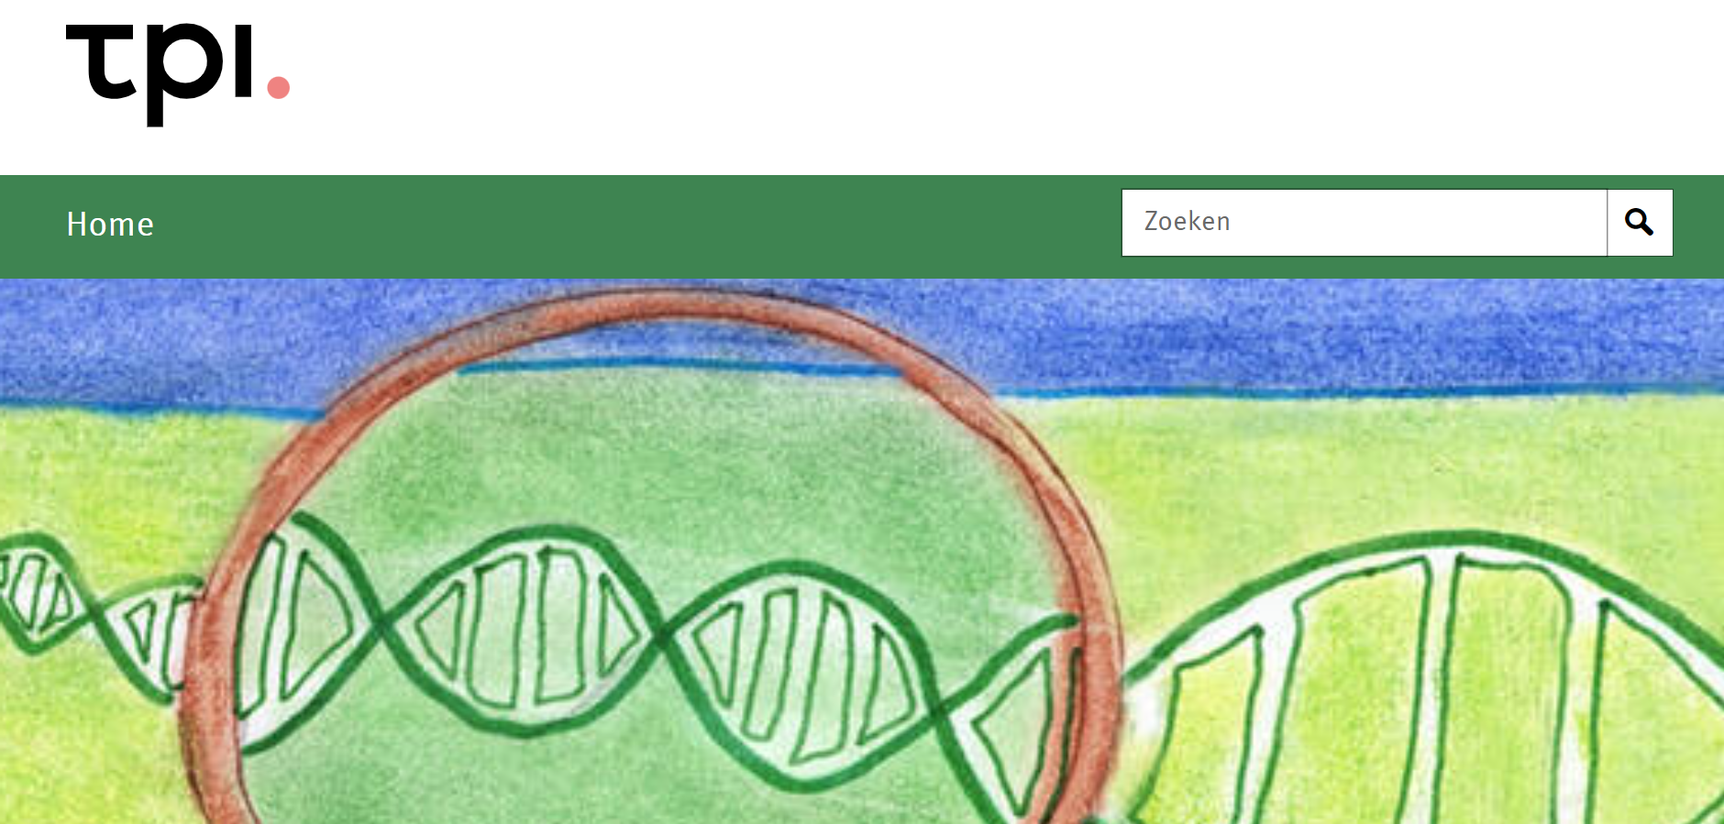
The Netherlands aspires to be a front leader in innovations that will render animals in research obsolete. Therefore the country stimulates development and implementation of methods of animal-free research. This takes place in the partner program Transition Research Animal-free Innovation (TPI).

Slide 28
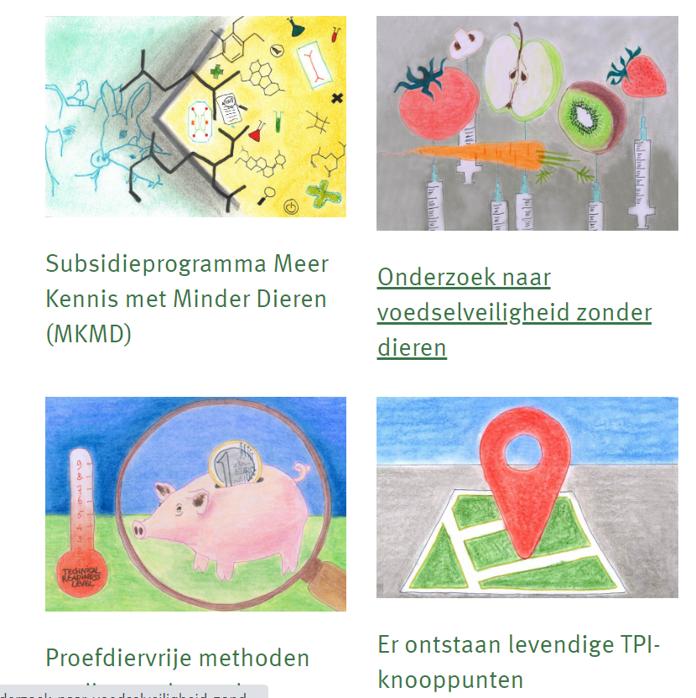
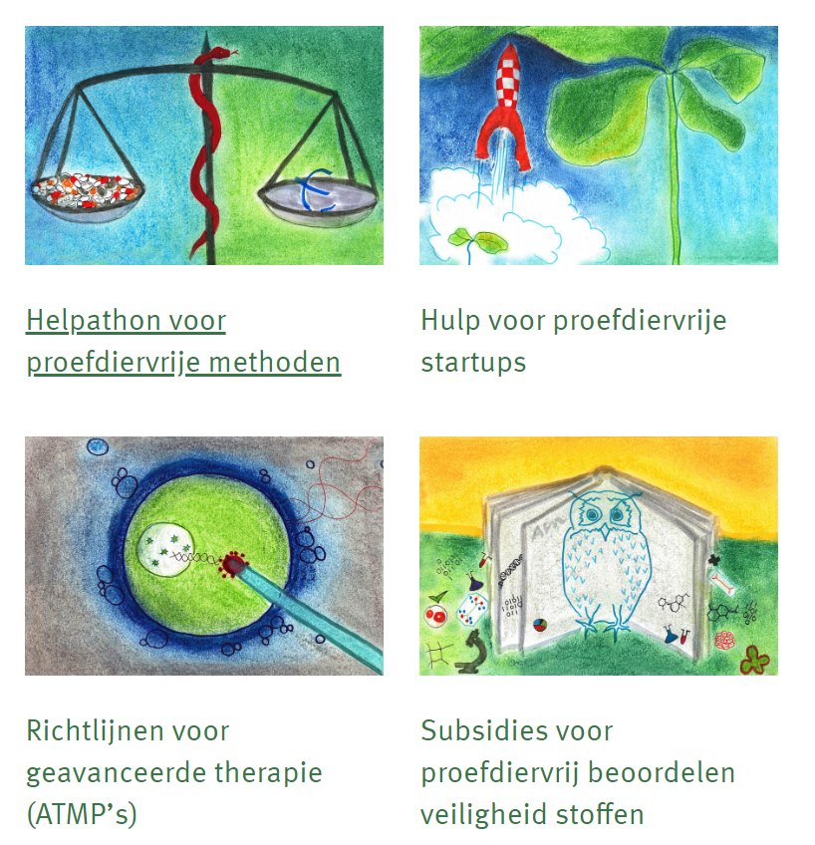

Slide 30
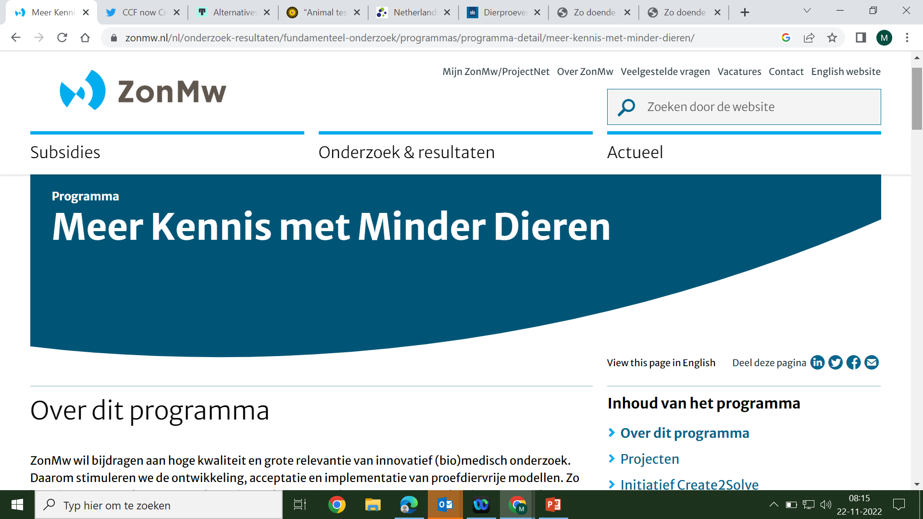

Slide 31
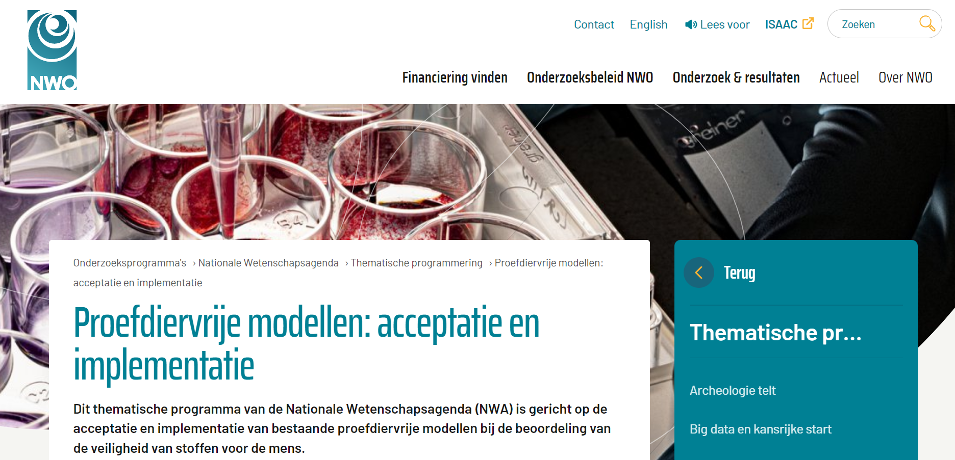

Slide 32
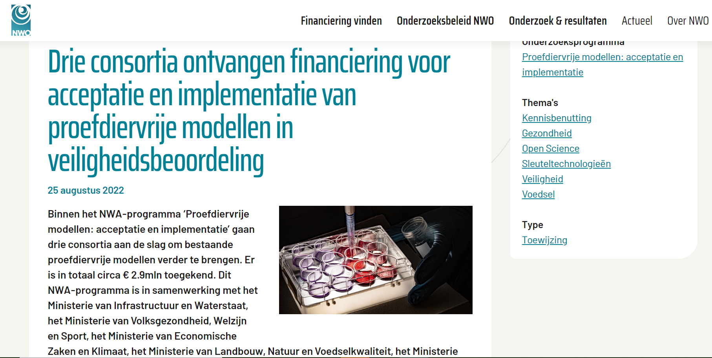

Slide 33
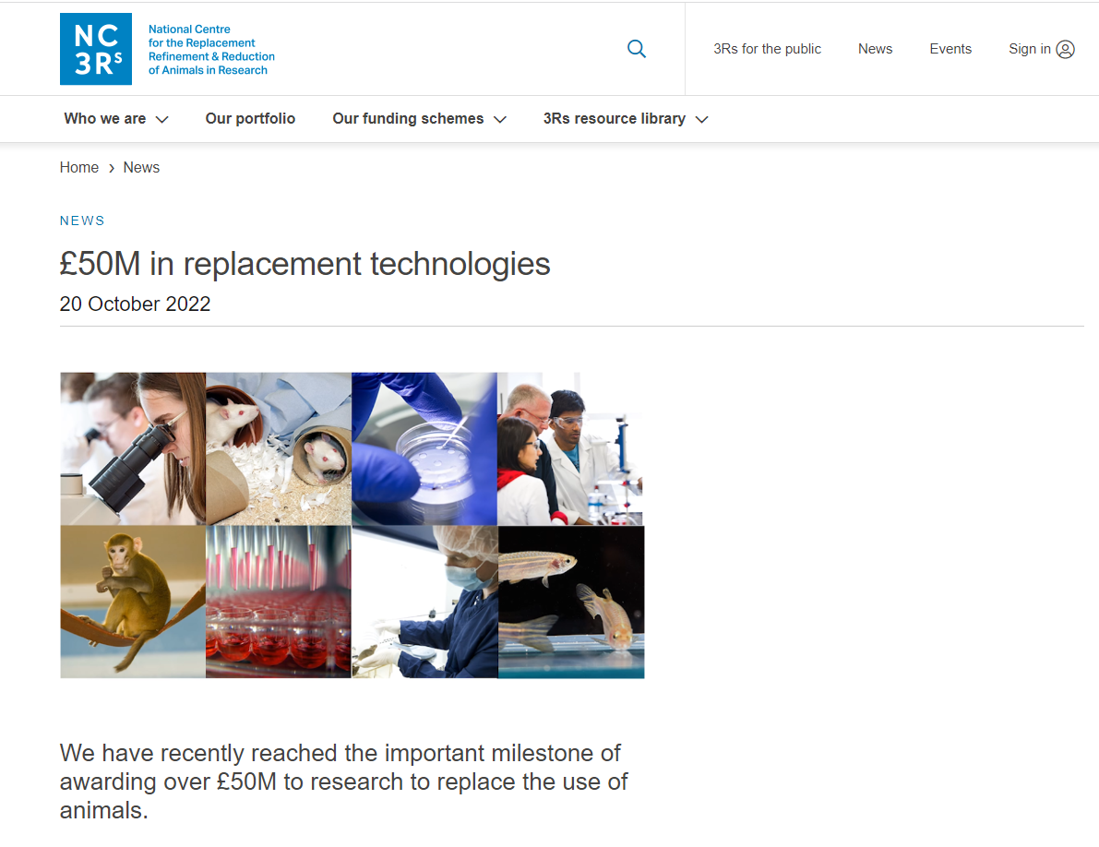
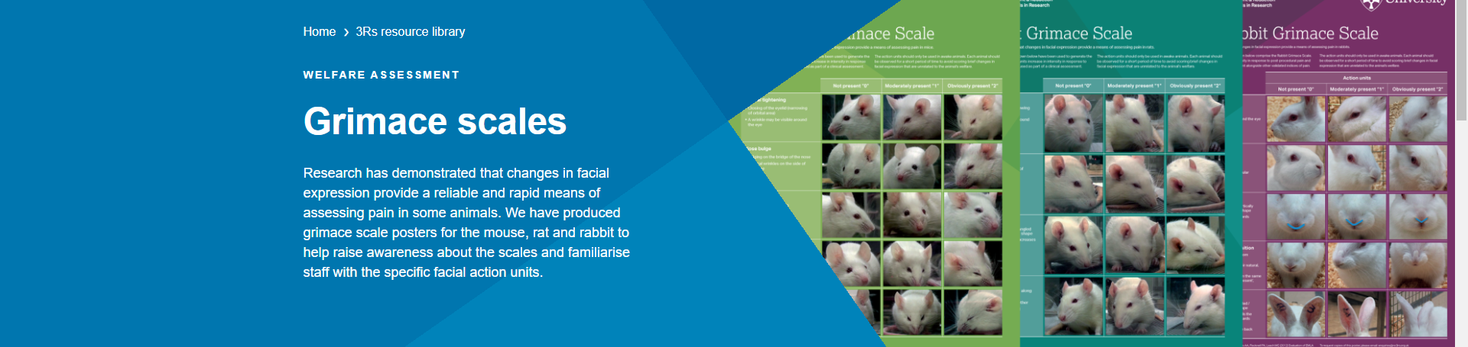

Slide 34

The solution for most societal problems ...
… will come from research and innovation

